Slide 1
THE LAW REVIEW COMMISSION OF ZANZIBAR
ALRAESA CONFERENCE
29TH JUNE, 2017 MAURITIUS
TITLE: SMALL LAW REFORM AGENCIES, ZANZIBAR EXPERIENCE
PRESENTED BY : JUSTICE MSHIBE ALI BAKARI

Slide 2
HISTORICAL BACK GROUND
Due to the social, political, economic and cultural changes that took place in Zanzibar, since revolution 1964. The Revolutionary Government of Zanzibar observed the need of a constant nourishment of our laws.
Therefore the Commission as an independent body was established under Section 3 of the Law Review Commission of Zanzibar Act No: 16 of 1986.

Slide 3
It’s Powers
The Commission has power to review all Laws of Zanzibar
All laws which are subject of the Union between Zanzibar and Tanganyika are being review by the Law Reform of Tanzania, however, the matter under review must be passed by the House of Representative so as to be applicable in Zanzibar.

Slide 4
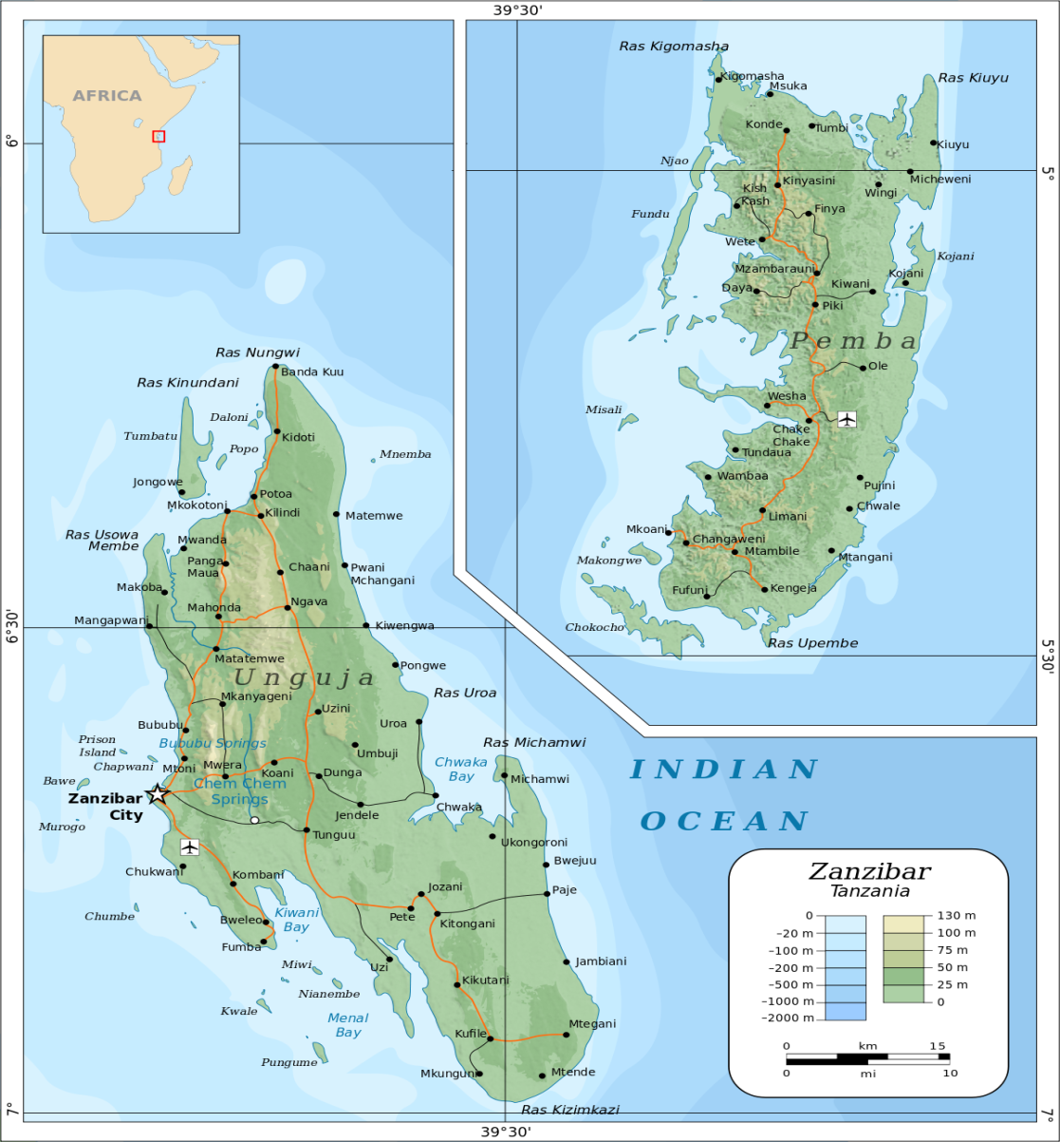
The Zanzibar Islands

Slide 5
REVIVAL OF THE COMMISSION
Despite the fact that the Commission was established in 1986, it was not effective for almost 24 years due to so many reasons, where by political instability was one among them.
The Commission was therefore revived at the end of 2010, where the Chairman, Secretary and the Commissioners were appointed, which marked the starting point of our journey.

Slide 6
Factors that lead to the Commission’s success
1. Set comprehensive strategic Plan.
2. Adhere to accomplish its objectives by proper utilising the little resources that We have.

Slide 7
1. Set comprehensive strategic Plan.
Prepare the organisation structure.
We improve our human resource from 5 employees to 27 within 6 years.
Establish the tendency of capacity building annually.
Creating conducive working environment by providing working equipments and healthy facilities.
Attain a permanent office after 3 years.
Have an independent budget.

Slide 8
2. Adhere to accomplish the Commissions objectives.
We set crucial programs for review in order to draw attention to the public as for them to realise the importance of the Commissions E.g. ( Law of Evidence Cap.5/1917, Criminal Procedure No.7/2004 e. t. c).
We planned properly and Utilised effectively a little financial resource that we have to any planned project. ( we have to adjust our selves according to our means and most of the work are done on volunteering bases),

Slide 9
We stick to the review procedures that insist in public participation which we find to be a potential source of research to enhance our laws in relation to the change of our society.
legal comparative research, Expert consultations and Stakeholders’ meeting are being conducted and held from time to time so as to produce an active and effective reports.

Slide 10
The management establish an element of unity and commitment among the staff. This attitude of ownership create a working moral among the members of the Commission, which facilitates achievement of our co function.
Attitude to ask for support. The Commission from time to time asks for hand from well experienced law reformers, might it be material support, training e.tc

Slide 11
Challenges of the Commission
Improper financial support in the past five years. However, the situation has changed, starting the financial year 2017/2018 the Commission has started with new trend of a reasonable financial support from the Government, which will speed up the achievement of its co function.

Slide 12
Poor collaboration of those implementers whose law is being reviewed by the Commission.
External pressure of some institutions which require their laws to be reviewed in one night and tend to ignore the process of The Law Review Commission.

Slide 13
COMMISSION SUCCESSES WITHIN 6 YEARS OF IT’S REVIVAL
Total of 17 laws have been reviewed from 2011-2016.
Total of 6 projects are in progress and are expected to be submitted at the end of this financial year, June 2017.
Training, equipments have been maintained and purchased at a reasonable standard.

Slide 14
How does the Commission face it’s Challenges
The Commission uses the principle of transparency to explain its position, role and the expected outcome to the stakeholders involving institutions. This helps them to identify their participatory role and obligations to wards the Commission’s mission.

Slide 15
The Commission always identify its strengths and weaknesses and identify factors that will contribute to its culture of continuous improvement.
We believe Challenges are always part of initiating the way forward to wards success and development. So, We, the Commission have to take them, face them believing that there should be no turning back.

Slide 16
Conclusion
We are proud to say that we started with nothing, nor where to learn or depend but because we stick on our mission and We pave the vision, everything is going smoothly towards our success.
Together! We have managed to make it runs!!!

Slide 17
Thank you for your attention.

